Slide 1
INFORMS Annual Meeting
Hybrid Modeling for Electricity Policy Assessments
Renato Rodrigues

Slide 2
Contents
Introduction How is it different? How do we do it? What is it worth? Conclusions
Introduction
How is it different?
How do we do it?
What is it worth?
Conclusions

Slide 3
Introduction:
Introduction How is it different? How do we do it? What is it worth? Conclusions
  Bottom-up models. (Ex: unit commitment, power expansion planning,…)
  Top-down models. (Ex: CGE models).
  Technology detail in top-down models. (CCGT, wind, nuclear,…)
  Electricity generation market characteristics:
  Geographical;
  Technology;
  Load Block.
  Load block disaggregation allows more complete policy evaluations:
  Average versus marginal prices;

Slide 4
Introduction
Introduction How is it different? How do we do it? What is it worth? Conclusions
  Case study:
    Active household demand response potential savings in Spain
Consumption variation with ADR
Appliance | Displacement | Reduction | ADR actions
Washing machine | 100% | 40% | Full shutdown
Dishwasher | 100% | 40% | ECO program
Dryer | 100% | 20% | Limitations
Water heating | 50% | 30% | stop / partial shutdown
Heating | - | 50% | Unacceptable shutdown
Air_conditioner | - | 50% | Power limitations, thermostat, time zones ...
Others | - | - | Non manageable
 |  | Direct effects detail |  | Indirect Effects
 |  | efficiency | displacement | efficiency | displacement
BU - electricity model |  | ok | ok
TD - CGE model |  |  |  | ok
TD - CGE with technology |  | ok |  | ok
Hybrid | TD - CGE with tech and time | ok | ok | ok | ok
 | Hard link hybrid model | ok | ok | ok | ok

Slide 5
How is it different?
Introduction How is it different? How do we do it? What is it worth? Conclusions
  Literature focused on detailing the electricity production technologies.
  Differences:
    First point: technological disaggregation in Top-down model is insufficient:
      Average price limitation
    Second point: exclusive calibration of Top-down data does not maintain the linkage with bottom-up technological parameters.
      Minimize entropy changes, distance…
What do we do?
  Develop a CGE (Top-down) model capable of load block time disaggregated evaluation
  Reconciliate the data between Top-down and Bottom-up alternatives without any intermediary adjustment stage.
  Develop a completely integrated hybrid model, with the electricity power generation expansion planning and the CGE model formulated as simultaneously solved MCP problems.

Slide 6
How do we do it?
Introduction How is it different? How do we do it? What is it worth? Conclusions
  Identify costs in the BU model and associated parameters:
  Approximate the technological parameters to reflect the Top-down aggregate
Cost type | Associated technology parameters
Fuel | Thermodynamic efficiency, generated power, fuel price
Variable O&M | Variable O&M costs by technology, generated power
Fixed O&M | Fixed O&M costs by technology, installed capacity
Capital | Overnight costs, construction time, years of amortization, real discount rate, interest rate , installed capacity
Labor | labor use by technology, installed capacity, social contributions
Taxes | Direct and indirect taxes, renewable subsidies,…
Own consumption | electricity own consumption by technology, electricity price
Losses | electricity losses in the grid, electricity price
Pumping | pumping efficiency an generated power, electricity price
Total electricity costs
32,000,000 M€

Slide 7
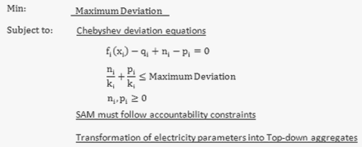
How do we do it?
Introduction How is it different? How do we do it? What is it worth? Conclusions
  Min-Max formulation:
    Lineal;
    Optimal deviations are estimated to be at the same neighbor.
  Fixed costs distribution by
  load blocks;
    Annual O&M; installed capacity amortization; new capacity installation;…
  Non accounted costs
    Ramp and Startup costs;…
  Market failures:
    Presence of non competitive market power rents; windfall profits;…
Min Max Deviation
Low load
p
CCGT
Fuel oil
Nuclear
Carbon
q
High load
p
Carbon
CCGT
Fuel oil
Nuclear
q

Slide 8
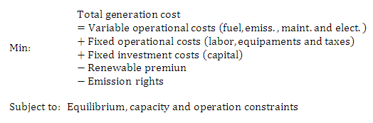
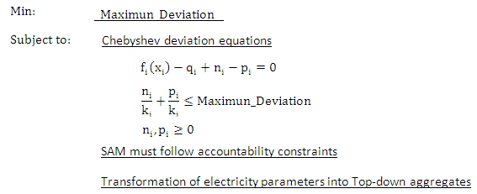
How do we do it?
Introduction How is it different? How do we do it? What is it worth? Conclusions
power generation operation and expansion
Electricity prices
Fixed costs distribution by load blocks
Non accounted costs and market imperfections rents
Min Max Deviation
Extended SAM
with technology and load block disaggregation
Adjusted technology parameters

Slide 9
How do we do it?
Introduction How is it different? How do we do it? What is it worth? Conclusions
power generation operation and expansion
Electricity prices
Fixed costs distribution by load blocks
Non accounted costs and market imperfections rents
Min Max Deviation
Repeat the process until convergence is reached between technology parameters
Adjusted technology parameters

Slide 10
How do we do it?
Introduction How is it different? How do we do it? What is it worth? Conclusions
  Min-Max iterative calibration simulation:
  Quadratic iterative calibration simulation:

Slide 11
What is it worth?
Introduction How is it different? How do we do it? What is it worth? Conclusions
  Active household demand response simulation results
Electricity sector direct effects only:
  Quantities for each technology;
  Prices for each load block.
Indirect effects simulation under only one electricity product:
  Fixed quantity change;
  Unique electricity price.
Direct and indirect effects simulation for each load block behavior:
  Quantities for each technology;
  Prices for each load block.

Slide 12
Conclusions:
Introduction How is it different? How do we do it? What is it worth? Conclusions
We presented a method to introduce explicitly load block disaggregation in the CGE formulation
  Described the calibration process which allows the development of a:
    pure CGE geographical, technology and load block disaggregated;
    hybrid integrated CGE and power generation operation expansion model under mixed complementarity formulation.
Advantages of such approach:
  Improved representation of the electricity sector behavior;
  Feasibility of the method;
  Convergence of the algorithm;
  More realistic results for policy evaluations.

Slide 13
?
Thank you for your attention!
Questions and comments are welcome!

